Slide 1

Introduction
Elliott Taguchi Dickinson Master’s student 2025/2026

Slide 2
What I’ve learned so far

Slide 3
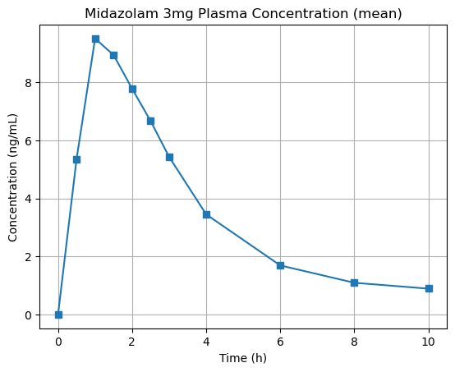

Python (to some extend)
Basic operations (loops, dictionaries etc)
Reading and understanding code
debugging
Most importantly the packages I will use such as pandas, numpy and matplotlib
https://pubmed.ncbi.nlm.nih.gov/22725836/

Slide 4
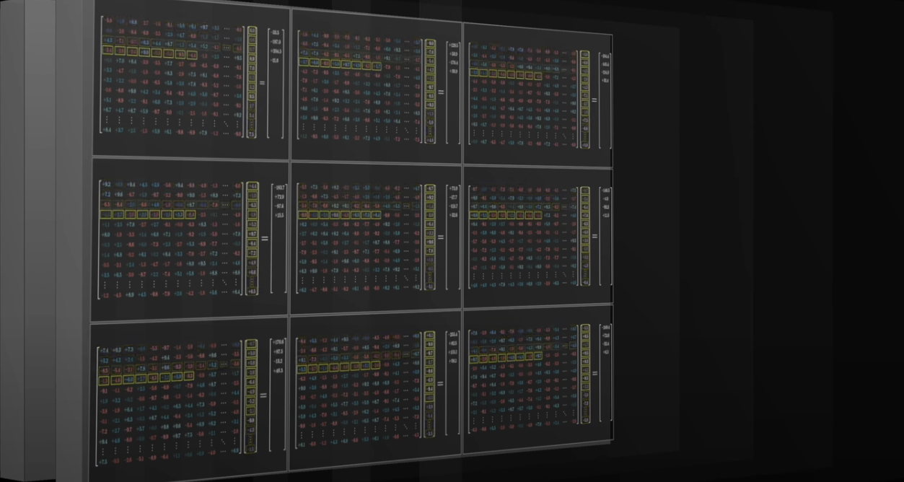
Machine Learning theory
Some general definitions when working with DLDM’s - what they are, why they are useful, and how we validate and examine the results they give us.
Measurements like RMSD and pLDDT.
Trying to understand what actually happens when you give AlphaFold3 a protein sequence and a ligand
Not the math (anymore)! But the concept, structure and architecture of these models, and what goes on in each part (Template module, MSA Module, the Pairformer etc).
Neural networks and weights.

Slide 5
What I’m currently working on

Slide 6
More python!
More theory!
Getting better at using the packages
Objects and classes
Weekly assignments for the programming course I’m taking
(And also setting up GitHub)
PoseBusters v2, DDD and benchmark datasets
Backwards propagation
Neural networks
Attention
Softmax
Cost function
Understanding pLDDT better
Notes:
Baclwards prop, neural networks and attention is not what I need to focus on.
Understand LDDT before pLDDT.

Slide 7
What my project will be about

Slide 8
It’s two fold:
1) The continued validation of DL-methods by applying them to DDD.
2) Automating the workflow for continued updates of the DDD database.

Slide 9
A rough outline for the project for the rest of this year
September-October: Learn Python, understand the theory, pass my course, prepare for the exam – this part is all about learning method and theory so I’m well suited. Hopefully also start benchmarking some DLDM’s against DDD.
November: Exam (November 7th). And then start actually working on some relevant data and benchmark against DDD. Also look into how the workflow can be automated.
December: Hopefully start looking into the statistical analysis I’ll be using.

Slide 10
Plan for the coming weeks

Slide 11
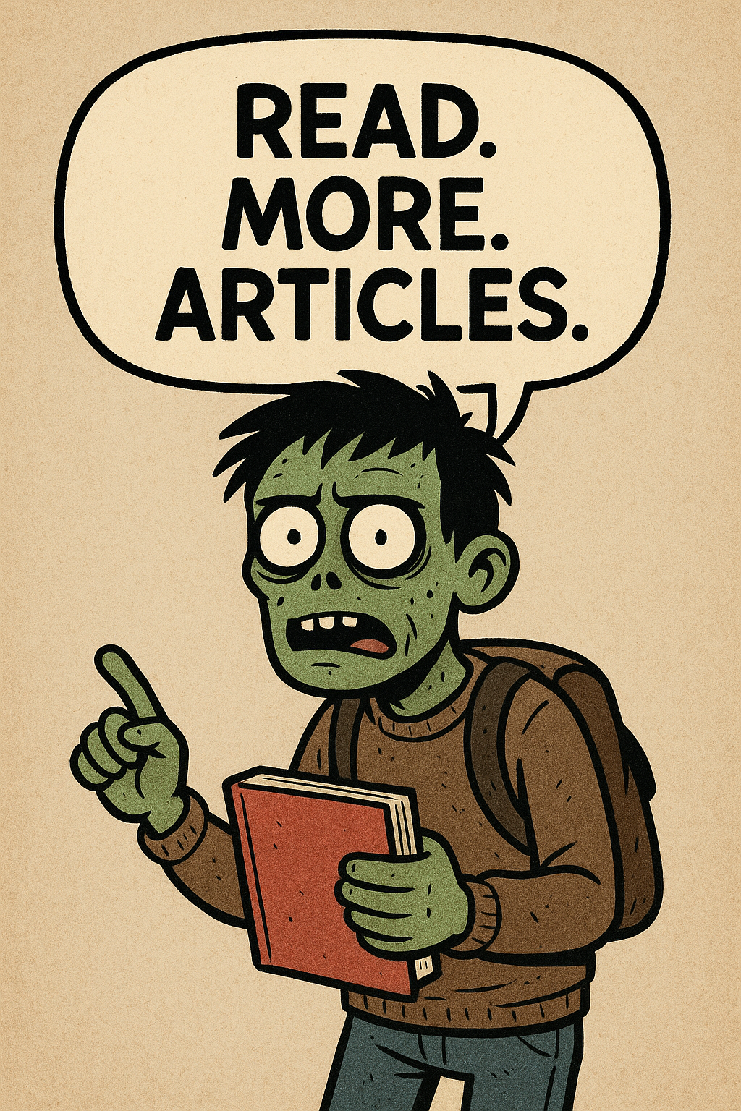
Get smarter!
Look into Boltz-2 and learn to benchmark it against DDD.
Analyse more data, get comfortable with the modules.
Get better at coding by following the course, and continue to practice on my own as well.
Read. More. Articles.
Notes:
Get real data.

